Slide 1
Windows Client Installation and User Guide
TRIAD 4.1

Slide 2
Hardware & Software Requirements
Hardware requirements (recommended):
4 GB RAM
2.4 GHz Processor
60 GB Hard Disk space
Software requirements:
Microsoft .NET 4.0 Framework Full Version (requires administrative privileges on the computer to install)
OS: Window XP (SP2, SP3), Windows 7 (32 or 64 bit)

Slide 3
Installation
Please open the following link to install TRIAD 4.1 Windows Client:
https://triad4.acr.org/triadclient3S/
TRIAD will launch after the installation is completed successfully.
Please make sure you register for a TRIAD account before you login to the Windows Client. Details on how to register are provided in the TRIAD User Registration User Guide.

Slide 4
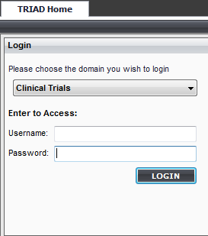
Logging in to TRIAD
After successful installation the TRIAD Client will automatically launch.
Use the Username and Password that you have received when registered on TRIAD website
Domain (selectable drop-down menu)
Username
Password

Slide 5
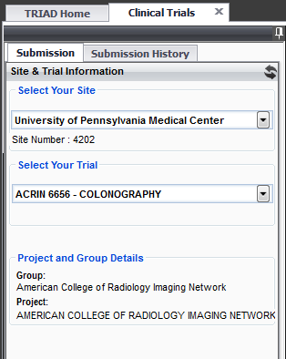
Select Site & Trial Information
Select the Site & Trial from the dropdowns for which the files are to be uploaded

Slide 6
Submission Sources
TRIAD provides features for submitting files from multiple sources:
Local computer / network drive: Files can be located in local computer folders, local CD/DVD drives or network drives. There are two ways to get upload data:
Files: User can select single or multiple files
Folders: User can select a folder and by selecting folder, all files in the folder will also be selected automatically
PACS: TRIAD has ability to query PACS for the study to submit

Slide 7
Submit Files from Computer / Network Drive

Slide 8
Submit Files from PACS (1/4)
Click here to get the DICOM info to be given at PACS side.
Click ‘Manage’ to add information of PACS from where you will retrieve files
Select ‘Choose Files from PACS’ and click ‘Choose Files’ button to open a new window to search for images in PACS.

Slide 9
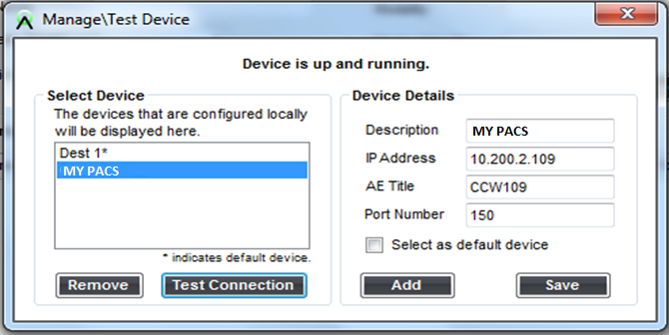
Submit Files from PACS (2/4)
Click “Add” in the pop-up window and provide details for your PACS
Click “Test Connection” to verify the connectivity
Click “Save” to save device details and close the window

Slide 10
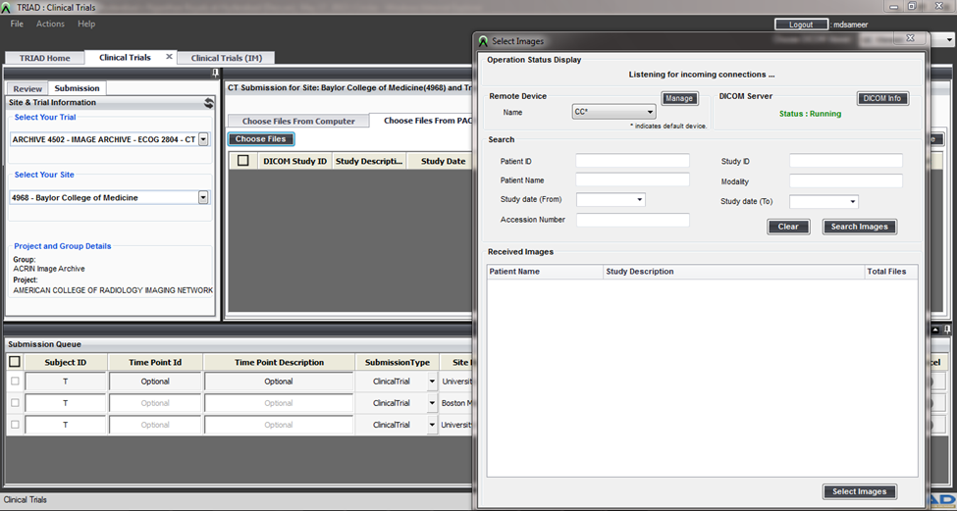
Submit Files from PACS (3/4)
Click here to get the DICOM info to be given at PACS side.
Configure the PACS with these details.

Slide 11
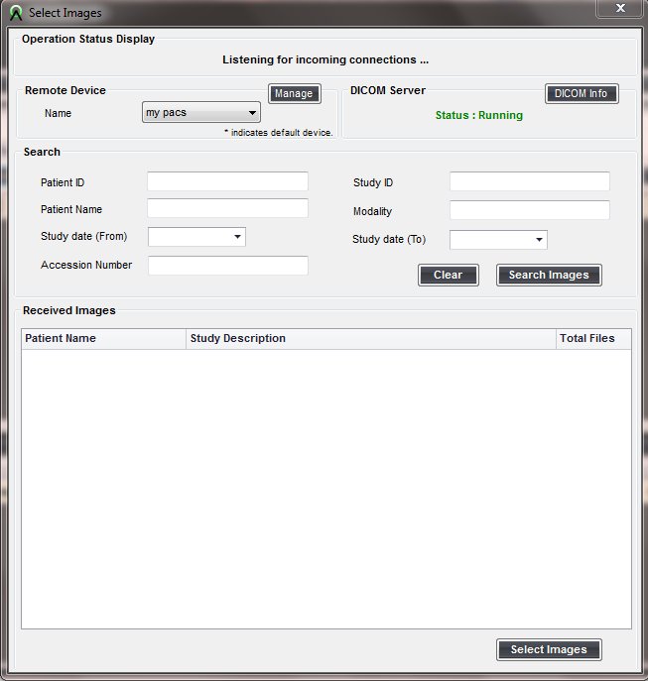
Submit Files from PACS (4/4)
Select PACS from dropdown
Provide the ‘Search’ details (Patient ID is mandatory) and click on ‘Search Images’
Select the images from search results by clicking the checkboxes
Click on ‘Select Images’ to load the selected files into TRIAD preview panel.

Slide 12
Preview Panel
Files selected from Computer/PACS are loaded into TRIAD preview panel
Click on ‘+’ icon to expand the DICOM study and view all the series in that study

Slide 13
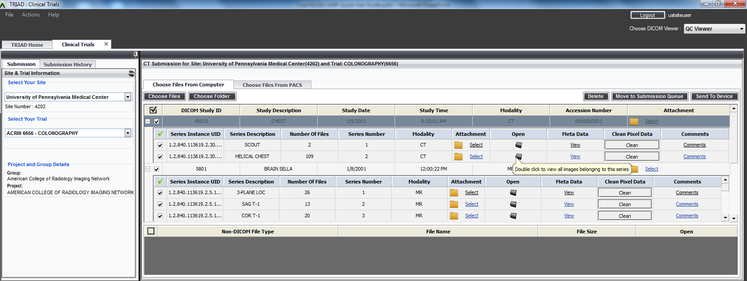
View Images
You can view the images in the preview panel before moving them to “Submission Queue”
Double click on the thumbnail to view images in series by using default “QC Viewer”.

Slide 14
Clean Pixel Data
You may clean any patient data that may be on the images by using ‘Clean Pixel Data’ feature.
Open the clean pixel data window by clicking ‘Clean’ button.
Draw a rectangle that would cover the data.
Click ‘Apply Pixel Data Cleanup’ icon to clean the area selected.

Slide 15
Add Attachments
You may add non-DICOM files, such as reports, at study or series level by clicking ‘Select’ in the ‘Attachment’ column

Slide 16
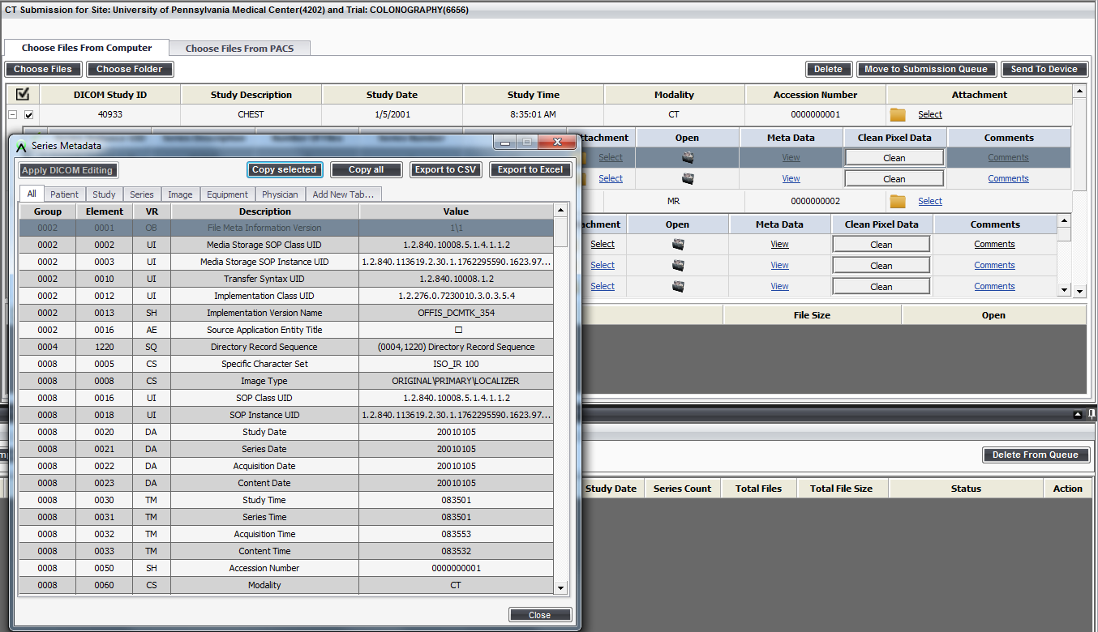
View DICOM Metadata
Click ‘View’ in the Metadata column to open the series metadata for the DICOM files in the preview panel.

Slide 17
Add Comments
You can provide comments for each series by clicking “Comments” link.
Click ‘Save’ after entering comments in the pop-up window.

Slide 18
Move for Submission
Select the series / series that are ready for submission by clicking the check boxes.
Click ‘Move to Submission Queue’ button to move the studies to Submission Queue

Slide 19
Submitting Files -- Submission Queue
Verify if all the studies are moved into Submission Queue.
Enter the proper subject ID in “Subject ID” field in the Submission Queue. TimePoint ID and TimePoint Description fields are optional.
Verify all the columns shown in the queue

Slide 20
Submission Queue -- Submission Type
Select the Submission type from the dropdown.
Clinical Trial -- default
Test Submission
Quality Assurance

Slide 21
Submission Queue -- Anonymization Result
You may view DICOM header anonymization results by clicking ”Anonymization Result” button. Both the Original Value and De-identified value are shown in the results pop-up windows.
An ‘Export’ button is also available to export the anonymization results in the form of pdf or word document and save it in your computer.

Slide 22
Validation Result
Click the “Validation Result” to check whether the series have the values to satisfy for the requirements of the trial
You may also check how many of the series are in Range or Out of range of the validation parameters and how many are not validated
System will allow you to submit the studies irrespective of the validation result

Slide 23
Submission Queue -- Submit Studies
Click “Complete Submission” when you are ready to submit the files to ACR
Anonymization and validation will be done in the background even if you did not select “Anonymization Result” or “Validation Result” before.
System shall change the status to ‘Green Color’ after the files are submitted successfully

Slide 24
TRIAD Support
If you have any questions or issues, please contact ACR TRIAD support services
Support Hours: 8:30am – 5pm EST Monday – Friday except ACR observed holidays
Support contact:
Phone: 215-940-8820; E-mail: triad-support@acr.org

